Slide 1
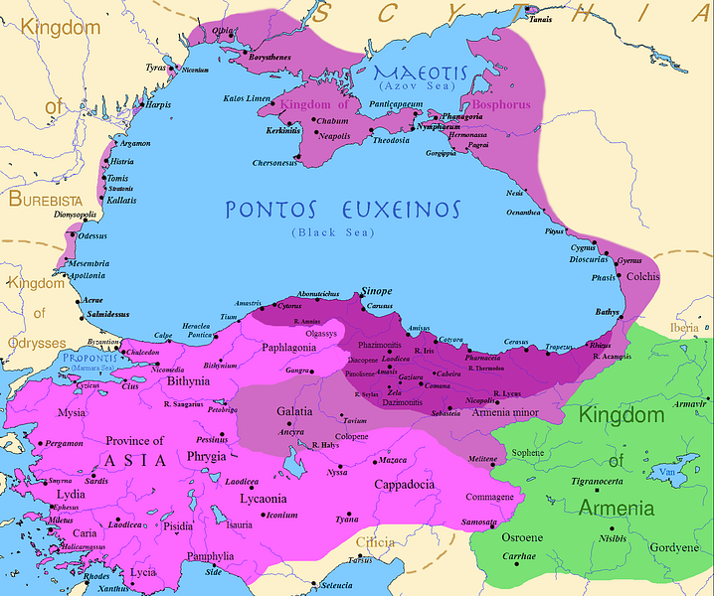
First Mithridatic War
GOAL/S: Describe the causes, HC, and effects of the First Mithridatic War
Week 2, Lesson 2

Slide 2
Watch the following:
https://www.youtube.com/watch?v=zVfTDi7AuF4&ab_channel=Jabzy

Slide 3
The Mithridatic Wars were three conflicts fought by Rome against the Kingdom of Pontus and its allies between 88 – 63 BCE. They are named after Mithridates VI (4), the King of Pontus during the wars who initiated the hostilities after annexing the Roman province of Asia into its Pontic Empire (that came to include most of Asia Minor) and committing massacres against the Roman inhabitants there. Mithridates was able to organise revolts against advancing Roman troops and play off the political factions of the optimates and populares against one another in the Roman civil wars. Nevertheless, the first war ended with a Roman victory, confirmed by the Treaty of Dardanos signed by Sulla and Mithridates. Greece was restored to Roman rule and Pontus was expected to restore the status quo in Asia Minor.
Notes:
What does it mean to ‘annex’?

Slide 4
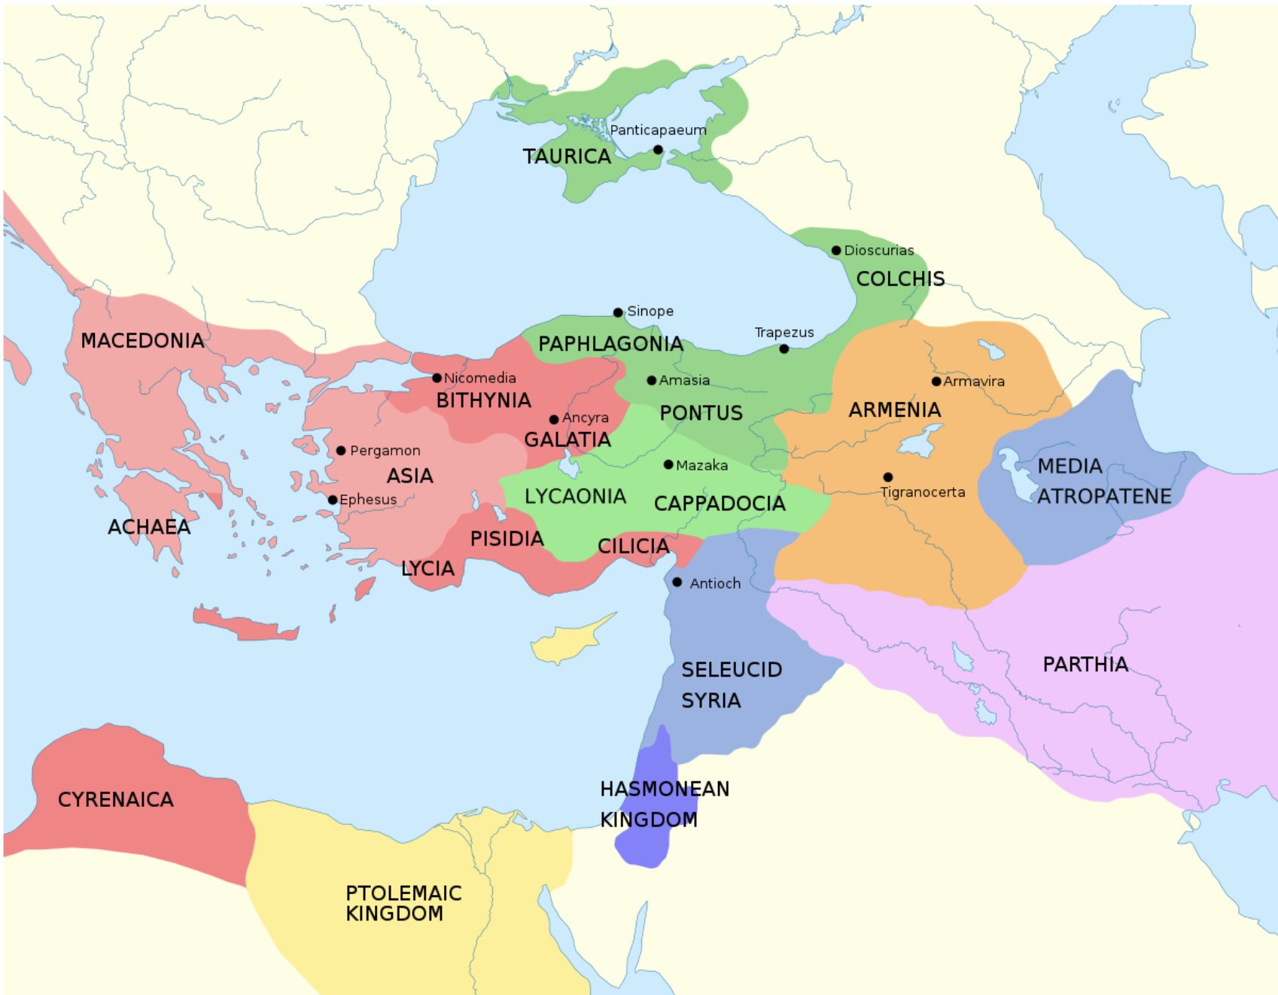

Slide 5
Map of the Pontic Kingdom
before the reign of Mithridates VI (darkest purple)
after his conquests (purple)
his conquests in the first Mithridatic wars (pink)

Slide 6
Important note:
Sulla played a significant role in the first mithridatic war (89 – 85BCE).
However, he was not directly involved in the subsequent mithridatic wars.

Slide 7
Activity – The First Mithridatic War
Using a piece of A3 Paper, create a STUDY SHEET about the First Mithridatic War
Include the following:
Causes (6)
People (6)
Short Term Effects (4)
Long Term Effects (4)

Slide 8
The First Mithridatic War

Slide 9
Causes – TEACHER ONLY
Expansion of Roman Influence: The Roman Republic had been steadily expanding its influence in the Mediterranean region, including in the eastern territories previously controlled by Hellenistic kingdoms. This expansion brought Rome into contact with powerful states such as Pontus, ruled by King Mithridates VI.
Rivalry between Rome and Pontus: There was a longstanding rivalry between Rome and Pontus over control of territories in Asia Minor (modern-day Turkey) and the Black Sea region. Both powers sought to extend their influence and control strategic trade routes in the area.
Dynastic Ambitions of Mithridates VI: Mithridates VI, also known as Mithridates the Great, aimed to expand his kingdom and challenge Roman hegemony in the region. He saw himself as a legitimate successor to the Hellenistic rulers and sought to unite Greek and non-Greek peoples against Roman domination.
Roman Interference in Asia Minor: Mithridates viewed Roman interference in the internal affairs of Asia Minor as a threat to his kingdom's sovereignty. This perception was fueled by Roman support for certain client kings in the region, which Mithridates saw as encroachment on his authority.
Massacre of Roman Citizens: Tensions between Rome and Pontus escalated following the massacre of Roman citizens and allies in Asia Minor in 88 BCE. Mithridates's forces attacked Roman citizens in retaliation for Roman interference in the region, leading to outrage in Rome and a call for war.
Political Instability in Rome: The political situation in Rome, characterized by power struggles between factions led by figures such as Gaius Marius and Lucius Cornelius Sulla, also contributed to the outbreak of the war. The transfer of Mithridatic command to Marius by the tribunate further exacerbated tensions and contributed to the conflict.

Slide 10
People – TEACHER ONLY
Mithridates VI of Pontus: Mithridates VI, also known as Mithridates the Great, was the king of Pontus during this period. He was the central figure leading the resistance against Roman expansion in the eastern Mediterranean. Mithridates was a skilled military commander and a shrewd politician who sought to challenge Roman hegemony in the region.
Lucius Cornelius Sulla: Sulla was a prominent Roman general and politician who initially held command against Mithridates in Asia Minor. However, his command was controversially transferred to Gaius Marius by the tribunes, leading to political turmoil in Rome. Sulla's rivalry with Marius played a significant role in the events leading up to the war.
Gaius Marius: Marius was another influential Roman general and politician who played a central role in the First Mithridatic War. He was a key figure in the transfer of Mithridatic command from Sulla to himself, which contributed to the escalation of tensions between Rome and Pontus.
Roman Senate: The Roman Senate, as the governing body of the Republic, played a crucial role in making decisions regarding foreign policy and military matters. While the Senate initially supported Sulla's command against Mithridates, the transfer of command to Marius by the tribunes circumvented Senate authority and intensified the conflict.
Tribunes of the Plebs: The tribunes of the plebs were elected officials tasked with representing the interests of the common people (plebeians) in Rome. In the lead-up to the war, certain tribunes supported Marius and facilitated the transfer of Mithridatic command to him, contributing to the political upheaval in Rome.
Client Kings and Allies: Various client kings and local allies in Asia Minor and the eastern Mediterranean region were involved in the conflict, either supporting Rome or Pontus based on their own interests and alliances. These included rulers such as Nicomedes IV of Bithynia and Tigranes the Great of Armenia, whose actions influenced the course of the war.

Slide 11
Short Term Effects - TEACHER ONLY
Short-Term Effects:
Military Campaigns: The war involved a series of military campaigns and battles in Asia Minor and the eastern Mediterranean, resulting in significant loss of life and resources for both sides. It led to the deployment of Roman legions and naval forces to the region, causing disruptions to local populations and economies.
Political Turmoil in Rome: The transfer of Mithridatic command from Lucius Cornelius Sulla to Gaius Marius by the tribunes exacerbated existing political tensions in Rome. This event contributed to the outbreak of civil strife known as the Social War (91–88 BCE) and later the Sulla-Marius conflict (88–87 BCE), which plunged Rome into political chaos and violence.
Sulla's Rise to Power: The political instability in Rome created an opportunity for Sulla to assert his authority. Sulla, after being stripped of his command in the Mithridatic War, marched his army on Rome in 88 BCE, sparking a civil war against Marius and his supporters. Sulla emerged victorious and established himself as a dominant figure in Roman politics.

Slide 12
Long Term effects - TEACHER ONLY
Long-Term Effects:
Consolidation of Sulla's Dictatorship: Sulla's victory in the civil war allowed him to enact sweeping reforms and consolidate power. He established a dictatorship, initiating a period of authoritarian rule known as the Sullan regime. Sulla's constitutional reforms aimed to restore the authority of the Senate and limit the power of the popular assemblies, reshaping the Roman political system.
Continued Roman Expansion: Despite the challenges posed by the Mithridatic Wars and internal conflicts, Rome continued its expansion in the Mediterranean. The defeat of Mithridates in the First Mithridatic War did not resolve the underlying geopolitical tensions in the region, leading to further conflicts and conquests in the following decades.
Further Unrest in the Eastern Mediterranean: The First Mithridatic War laid the groundwork for subsequent conflicts between Rome and the kingdoms of the eastern Mediterranean, particularly Pontus and Armenia. The power vacuum created by Mithridates's defeat allowed other ambitious rulers, such as Tigranes the Great of Armenia, to assert themselves in the region, leading to further instability and conflict.

Slide 13

KEY EVENTS
Based on the names of the following, what do you think they’re about?
The Treaty of Dardanos signed by Sulla and Mithridates
The transfer of Mithridatic command to Marius by the tribunate

Slide 14
ACTIVITY – Key Events
Complete the worksheet
Read together as a class
Respond to the questions provided

